Slide 1
Mobility Models
CSE 494/535 Mobile Computing

Slide 2
What are mobility models?
Can we model how humans move?
Why?
Environment changes with mobility so do resources
Computing strategies change with environment
E.g. – No network, point of interest, state of mind, food ----
Mobility models are mathematical forms that tell us where, when and by how much a person is likely to move

Slide 3
Characteristics of human mobility
Random
Point of interest
Long journeys are ok
Periodicity
Varying speed
Varying directions
Probabilistic Models of Human Motion

Slide 4
Probability
Chance that and event A will occur.
Coin toss: heads and tails
P(heads) = 0.5, P(tails) = 0.5
Continuous domain: random variable X
Probability density function (f) and distribution (F)
f – probability that a continuous random variable takes a value within dx interval around x
F – P(X<x)

Slide 5
Finite Markov Chain
An integer time stochastic process, consisting of a domain D of m>1 states {s₁,…,s_{m}} and
An m dimensional initial distribution vector ( p(s₁),.., p(s_{m})).
An m×m transition probabilities matrix M= (a_{sisj})
For example, D can be the letters {A, C, T, G}, p(A) the probability of A to be the 1st letter in a sequence, and a_{AG} the probability that G follows A in a sequence.

Slide 6
Markov Chain (cont.)
X₁
X₂
X_{n-1}
X_{n}
For each integer n, a Markov Chain assigns probability to sequences (x₁…x_{n}) over D (i.e, x_{i} D) as follows:
Similarly, (X₁,…, X_{i} ,…) is a sequence of probability distributions over D. There is a rich theory which studies the properties of these sequences. A bit of it is presented next.

Slide 7
Markov Chain (cont.)
X₁
X₂
X_{n-1}
X_{n}
Similarly, each X_{i} is a probability distributions over D, which is determined by the initial distribution (p₁,..,p_{n}) and the transition matrix M.
There is a rich theory which studies the properties of such “Markov sequences” (X₁,…, X_{i} ,…). A bit of this theory is presented next.

Slide 8
Matrix Representation
A
B
C
D
The transition probabilities Matrix M =(a_{st})
0.95
0
0.05
0
A
M is a stochastic Matrix:
B
0.2
0.5
0
0.3
0
0.2
0
0.8
C
The initial distribution vector (u₁…u_{m}) defines the distribution of X₁ (p(X₁=s_{i})=u_{i}) .
0
0
1
0
D
Then after one move, the distribution is changed to X₂ = X₁M

Slide 9
Matrix Representation
A
B
C
D
0.95
0
0.05
0
Example: if X₁=(0, 1, 0, 0)
then X₂=(0.2, 0.5, 0, 0.3)
And if X₁=(0, 0, 0.5, 0.5)
then X₂=(0, 0.1, 0.5, 0.4).
A
B
0.2
0.5
0
0.3
0
0.2
0
0.8
C
0
0
1
0
D
The i-th distribution is X_{i} = X₁M^{i-1}

Slide 10
Representation of a Markov Chain as a Digraph
0.95
A
B
C
D
0.95
0
0.05
0
A
0.2
0.5
0
0.3
0.2
0.5
B
A
B
0
0.2
0
0.8
C
0.05
0.2
0.3
D
0
0
1
0
0.8
C
D
1
Each directed edge A→B is associated with the positive transition probability from A to B.

Slide 11
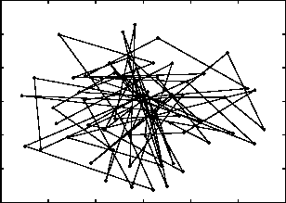
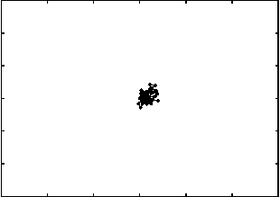
Random Walk Model
The Node Chooses a Random direction from [0, 2π]
and a random speed from [maxSpeed, minSpeed]and
moves along that direction.
The Nodes can either move for a constant distance or for time.
The Node repeats the above steps till the end of simulation.

Slide 12
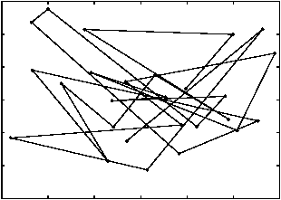
Random Waypoint Model
Node is initialized at a Random Location
The node after waiting for an initial pause time, picks a random destination and starts moving towards the destination at uniformly distributed random speed
Upon reaching the destination the node pauses for a Uniformly distributed random time.
Simulation Area
Notes:
Worse than markov’s

Slide 13
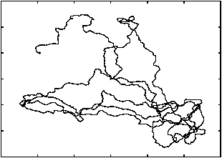
Gauss-Markov Model
The speed and direction of the n^{th} step depends
on the (n-1)^{st} step
S_{n} = alpha* S_{n-1} + (1-alpha)*S_{mean}+sqrt(1-alpha²)S_{xn-1}
d_{n} = alpha* d_{n-1} + (1-alpha)*d_{mean}+sqrt(1-alpha²)d_{xn-1}
alpha – tuning parameter
S_{mean} and d_{mean} are mean values of speed and direction
S_{xn-1} and d_{xn-1}are Random Variables from Gaussian distribution
When alpha = 0 we get totally random node movement
When alpha = 1 we get a perfectly linear node movement

Slide 14








Levy Walk Model
Random Walk
Levy Walk
1
1
0.9
Variance $σ=0.2$
0.9
Scale $c=5$
$$σ=0.5$$
$$c=2$$
0.8
$$σ=0.8$$
0.8
$$c=1.25$$
0.7
$$σ=1.0$$
0.7
$$c=1.0$$
0.6
0.6
0.5
0.5
Probability that distance travelled is x
Probability that distance travelled is x
0.4
0.4
0.3
0.3
0.2
0.2
0.1
0.1
0
0
0
0.5
1
1.5
2
2.5
3
3.5
0
0.5
1
1.5
2
2.5
3
3.5
Distance Travelled (m)
Distance Travelled (m)

